Slide 1
Graph Processing using Processing in Memory
- Supervisor: Muhammad Attahir Jibril
- Presenter: Krishna Kumar Ranganath

Slide 2
Introduction
What is Processing in Memory?
Processing in Memory (PIM) is a technology in which the memory units such as DRAM is integrated with processing capabilities.
Applications such as Graph Processing, Machine Learning (ML) and Artificial Intelligence (AI), Database Querying are usually memory bound, processing them in memory benefits in lower latency and higher bandwidth.
PIM reduces the traditional data movement bottleneck between the CPU and the memory by processing tasks in the memory.

Slide 3
Why Processing In Memory?
Benefits of PIM
In the traditional CPU architecture data is stored in the memory and processed in the CPU.
CPU Architecture | Processing in Memory
Processing takes place in the CPU | Processes data inside the memory
Slower processing for larger datasets | Faster processing for large datasets
Limited parallelization | Massive parallelization
Frequent data movement between CPU and Memory | Minimal data movement between CPU and Memory
Reduces data movement bottleneck.
Improves engergy efficiency, hence reducing power consumption.
Parallel Processing.
Accelerates processing speeds drastically.
Comparison between the traditional CPU architecture and Processing in Memory
Notes:
Preamble of the Mission Statement
„Teaching and research conducted at the TU Ilmenau are at the highest level in the field of engineering, mathematics and natural sciences, economics an the media. Particular importance ist being attached to innovation and interdisciplinarity in teaching.
The university identifies with Humboldt´s ideals in pursuing the vision of a cosmopolitan campus family .“
ATTENTION: Clicking on the image opens the image film of the TU Ilmenau on Youtube!

Slide 4
Research Objective
Processing the Single-Source Shortest path Algorithm using memory: Implementing the Bellman-Ford Algorithm using the UPMEM SDK and executing it on the UPMEM DRAM Processing Units (DPUs).
Comparison between the CPU and DPU Implementation: The algorithm is run on both the CPU and the DPU to check the time taken to execute the program and also validate the DPU implementation results using the CPU results.
Optimization of the algorithm: The algorithm is optimized to run in parallel by splitting the graph across multiple DPUs.
Notes:
5225 students have been enrolled at the university as of 31.10.2020, of which 1638 are international students from all continents and over 100 countries
That is 31 % of all students (2011: 10,8 %).
Of the 95 professors, 11 are endowed professors and 6 junior professors.

Slide 5
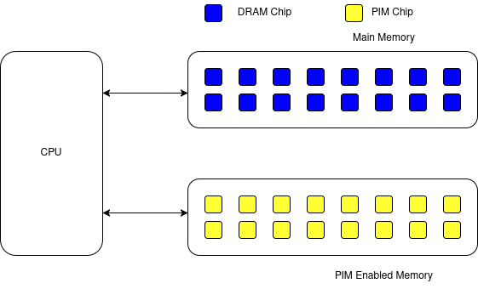
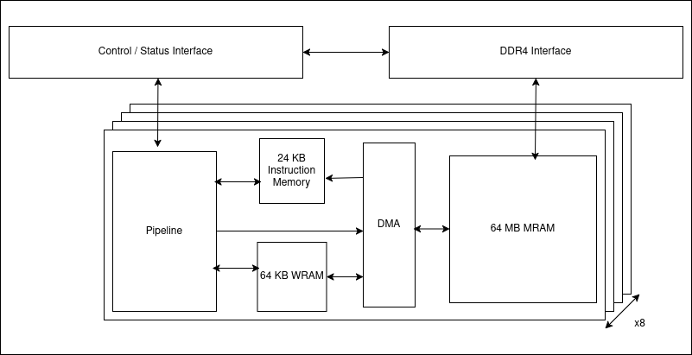
UPMEM DIMM Architecture
The UPMEM DIMM contains 8 or 16 PIM chips, inside each PIM chip there are 8 DRAM Processing Units (DPUs) which coexist in the system along with the standard DIMMs.
PIM Enabled Memory
Components of a PIM Chip

Slide 6
Important components of a DPU
Main Ram (MRAM): 64MB per DPU used to store the graph, and responsible for data transfer between host (CPU) and MRAM.
Working Ram (WRAM): Used for computation, tasklets load data from MRAM into WRAM for processing, volatile memory which holds frequently used data temporarily with a capacity of 64KB.
Instruction Memory (IRAM): Stores the executable code of the program having a capacity of 24KB.
Tasklets: Parallels threads inside each DPU, allowing parallelization in each DPU, each DPU can have upto 24 tasklets. Tasklets read data from MRAM into WRAM, and write the results back to MRAM.

Slide 7
Tools used for this implementation
Programming Language: C (for writing the Host and DPU programs), Python 3 (for generating input Graph text files)
Environment: UPMEM SDK
Operating System: Linux (Ubuntu server 20.04 LTS)
Text Editor: Visual Studio Code

Slide 8
Graph algorithms on the UPMEM DPUs
Processing large scale graphs on the CPU is challenging and takes a lot of time, whereas processing them in memory is quicker because there is minimal data transfer and there is an added advantage of parallelization.
To compute the shortest path from the source vertex to all other vertices in the graph the Bellman-Ford algorithm is implemented on the UPMEM DPUs
Why? Because it is easier to parallelize as it updates all edges in each iteration.
The input is a directed, weighted, dense graph read from a .txt file with the source vertex as 0 and all the vertices are connected either directly or indirectly to the source vertex.

Slide 9
Host Program and DPU Program
Writing programs using the UPMEM SDK involves two key files the Host program file and the DPU program file.
Host Program file: The role of the Host Program in this implementation is as follows:
Reading the Graph from the input text file.
Allocating the Number of DPUs and specifying the backend as simulator or hardware using the dpu_alloc() function.
Loading the DPU program into each DPU.
Partitioning the Graph across multiple DPUs.
Transferring the Graph Data to DPUs using dpu_copy_to() function.
Retrieving the updated distances from the DPUs using the dpu_copy_from() function.

Slide 10
Host Program and DPU Program
The updated distances processed by the DPU are compared with the CPU‘s result to ensure correctness.
The Host Program also calculates the execution time for both CPU and the DPU implementation.
DPU Program file: The DPU program processes the Bellman-Ford algorithm, and has the following role:
Contains the logic of the algorithm.
Tasklet Execution: Multi thread execution within DPUs.
Memory Declarations: The MRAM and WRAM buffers are declared at the beginning of the program.

Slide 11
Graph Partitioning Strategy
To process the Graphs, the edges are split across DPUs, each DPU gets allocated a subset of the Graph.
This ensures in reducing redundancy, decrease in execution time, lower power and memory usage.
The following formula is implemented in the program:
int edges_per_dpu = (no_of_edges + no_of_dpus-1) / no_of_dpus;
For Example:
Number of Edges = 20000 and Number of DPUs = 3, each DPU receives 6667 edges. Since the int datatype is used it truncates the value from 6667.33 to 6667.

Slide 12
Graph Partitioning Strategy
Next, inside the DPU_FOREACH() function the following logic is implemented:
int start_index = dpu_id * edges_per_dpu;
Int end_index = (start_index + edges_per_dpu < num_edges) ? (start_index + edges_per_dpu) : num_edges;
Initially dpu_id is set to 0 and it keeps incrementing upto the number of dpus because of the DPU_FOREACH() function.
According to this logic the following result is obtained:
dpu 0 receives 0 to 6667, 6667 edges.
dpu 1 receives 6667 to 13334, 6667 edges.
dpu 2 receives 13334 to 20000, 6666 edges.

Slide 13
Graph Partitioning Strategy
For dpu 2 after applying the formula it is observed that the end_index will be 20001 ((13334 + 6667 = 20001 < 20000) ? 20001 : 20000), the value is greater than the number of edges.
The ternary operator ‘?’ checks the condition and it results in false, in this case the number of edges is set as the end_index for the final DPU, and the final DPU receives 1 less edge than the rest.
After every relaxation step the Host (CPU) sends the updated distances retrieved from the DPU back to the DPU until (V – 1) times.

Slide 14
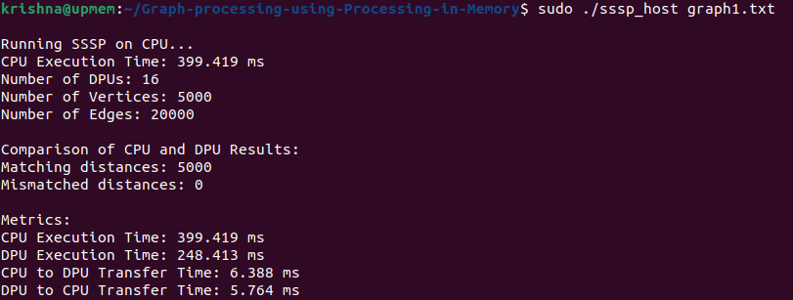
Result Analysis
The result of the implementation is displayed below with different test cases:
Small scale graph with 5000 vertices and 20000 edges using 16 DPUs and 16 tasklets:

Slide 15

Result Analysis
Medium scale graph with 20000 vertices and 50000 edges using 40 DPUs and 16 tasklets:

Slide 16
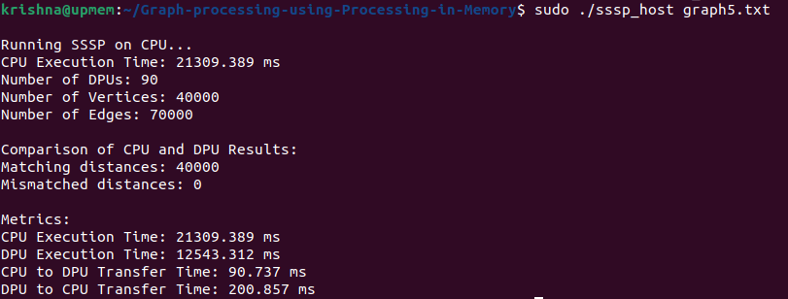
Result Analysis
Large scale graph with 40000 vertices and 70000 edges using 90 DPUs and 16 tasklets:

Slide 17
Future Optimization
Optimize the program to handle larger and complex datasets.
The Bellman-Ford algorithm can handle negative weights, the DPU program can be modified further to detect and handle negative weights in the Graph.
Graph partitioning method can further be optimized to distribute edges across the DPUs and synchronize them in a more efficient manner to reduce the execution time even further.

Slide 18
Conclusion
From the results it is observed that the DPU implementation reduces the execution time drastically.
Each DPU is assigned a subset of the Graph and the workload is getting distributed evenly and the edges are being processed simultaneously.
It is more efficient to use lesser number of DPUs for small scale graphs and increase the number of DPUs gradually depending on the size of the dataset.

Slide 19
Thank you!
Discussions
Credits: p. 1: Chris Liebold, p.2: iStockphoto.com/Creativeye99, p. 3/1 iStockphoto.com/Creativeye99 p. 3/2 Siemens AG, p. 16: Christian Meyer, p. 17: iStockphoto.com/Creativeye99, p. 20/1: Rüdiger Horn, p. 22: Nürnberg Luftbild/Hajo Dietz, p. 23/1: Thiemo Reindel, p. 23/2: hsf studentenradio e.V., p. 23/3: Christoph Gorke, p. 24/1: Thomas Golda, 24/2: Johann Lembach, p. 25: helibild, alll others: Michael Reichel / arifoto.de

